Slide 1

A PROJECT OF THE MICHIGAN RECYCLING COALITION WITH GRANT FUNDING FROM THE DEPARTMENT OF ENVIRONMENTAL QUALITY
Notes:
Introduction.
Good Morning, Thanks Chad and thanks for attending
I’m Hunt Briggs, the Project Leader for the MRI. I work with my colleagues here at RRS toward a waste free future. I’m happy to tell you about the Michigan Recycling Index effort. I’m joined by a couple members of our RRS project team including Nicholas Lange and Beth Coddington – They both led much of the research and analytics on the project.
Today I’ll talk about the:
Goals of the project
Tell you about The approach & methods we used and
Share the key results
Then I’ll “take off my MRI hat and put on my RRS hat” and speak for a few minutes about some “what if scenarios” and explore some specific program focus areas could be beneficial to help us achieve the Governor’s aggressive goal of boosting recycling rate to 30%.

Slide 2
Notes:
The project was supported by the MDEQ through a Pollution Prevention Grant
The Michigan Recycling Coalition administered the project and
RRS formed the project team to execute the work.

Slide 3

Notes:
We had the support of a top notch advisory committee to ensure that that project strategy was aligned with stakeholder expectations
Advisors represented members through the entire supply chain, including material recovery experts, processors, manufacturers and reprocessors, regional community leadership, and input & partnership with MDEQ
Name the members

Slide 4
THE GOALS
*
Notes:
Let’s start with the goals.

Slide 5
01.
02.
03.
Determine levels of access
Determine participation
Calculate the recycling rate
Notes:
We set out to answer three main questions.
“How many MI households have access to recycling at their home or in their community?”
Why is this important? Access is the first step to achieving diversion.
We gathered information on the number of
Municipal curbside programs including those that have contracted service
The number of Subscription curbside programs (in all their varieties)
And the # of Drop-off programs

Slide 6
01.
02.
03.
Determine levels of access
Determine participation
Calculate the recycling rate
Notes:
Second, we looked at participation.
Of those with access, how many participate in the recycling system?
Households that recycle relative to the total number of households tells you about the participation rate
For this, we looked at participation on an annual basis – not weekly/monthly since this information is not maintained by many programs
Another angle of participation measures ‘how much’ do people recycle, and we measure that in terms of LBs material per participating household
Why is it important? Need to know whether to target underperforming recyclers, or non-recyclers.

Slide 7
01.
02.
03.
Determine levels of access
Determine participation
Calculate the recycling rate
Notes:
3. We also gathered data on what was recycled in 2013 by michigan recyclers, which enabled us to calculate the recycling rate.

Slide 8
ACCESS
PARTICIPATION
+
→
RECYCLING RATE
Notes:
Access and Participation are the building blocks of recycling performance
Participation without access is impossible
Access without participation is futile
Together, they lead to effective recovery and the type of recycling rate we all want to see.

Slide 9
METHODOLOGY
*
Notes:
How exactly did we approach the challenge?

Slide 10
01.
02.
03.
Survey
the supply chain
Leverage industry, proprietary, and public data
Model Data Gaps
Notes:
Step #1 was to survey each level of the recycling value chain.
We developed a confidentiality agreement that gave assurance to stakeholders that we would handle their data securely. Since participation is voluntary, and we want to be respectful of company specific information that is sensitive / confidential.
For the survey,
- We began with Counties and Municipalities over 10k population.
- All municipalities, including Townships and Villages were welcome to voluntarily participate.
- Surveys were also administered to recycling facilities, haulers, and compost facilities.
- Paper mills and plastics reprocessors were interviewed and were requested to share data.-

Slide 11
01.
02.
03.
Survey
the supply chain
Leverage industry, proprietary, and public data
Model Data Gaps
Notes:
Step #2 involved gathering all available data to measure ‘take-back’ recycling amounts, such as carpet, batteries, textiles, white goods, electronics, tires, etc..
Certain quantities were in the public domain - clearly reported and available from DEQ, such as compost and e-waste.
Other materials required adjustments from their reported values in order to remain in line with MSW, such as tires (TDF removed) and batteries (adjusted from industry claim)
Some material was projected based on generation data provided by industrial or government sources (textiles and white goods).

Slide 12
01.
02.
03.
Survey
the supply chain
Leverage industry, proprietary, and public data
Model Data Gaps
Notes:
The community survey was completed by:
134 communities representing 40% of the states population. (much information was gathered, and a fraction of these had tonnage information)
56 counties representing 84% of the state population.
21 MRFs
So the last component was building a sophisticated model that could extrapolate the patterns of respondent communities to analogous communities for which we didn’t have data, and give us the most accurate measure of actual performance. For those gaps, we have the ability to estimate quantities of recovered material on a community-by-community basis using known information about their recycling system.

Slide 13
ACCESS TO RECYCLING
*
Notes:
Now let’s look at the first part of the equation.
Who has access to recycling, and what kind of access do they have?

Slide 14
What constitutes access to recycling?
Notes:
First, what do we even mean by access? Afterall, not all access is the same.

Slide 15
CURBSIDE
DROPOFF
Contracted
Subscription
Convenient
Minimal
Notes:
Two primary modes of access to recycling.
Curbside access includes municipally provided or contracted
And we break drop-off into convenient or simply minimal which I’ll explain shortly

Slide 16
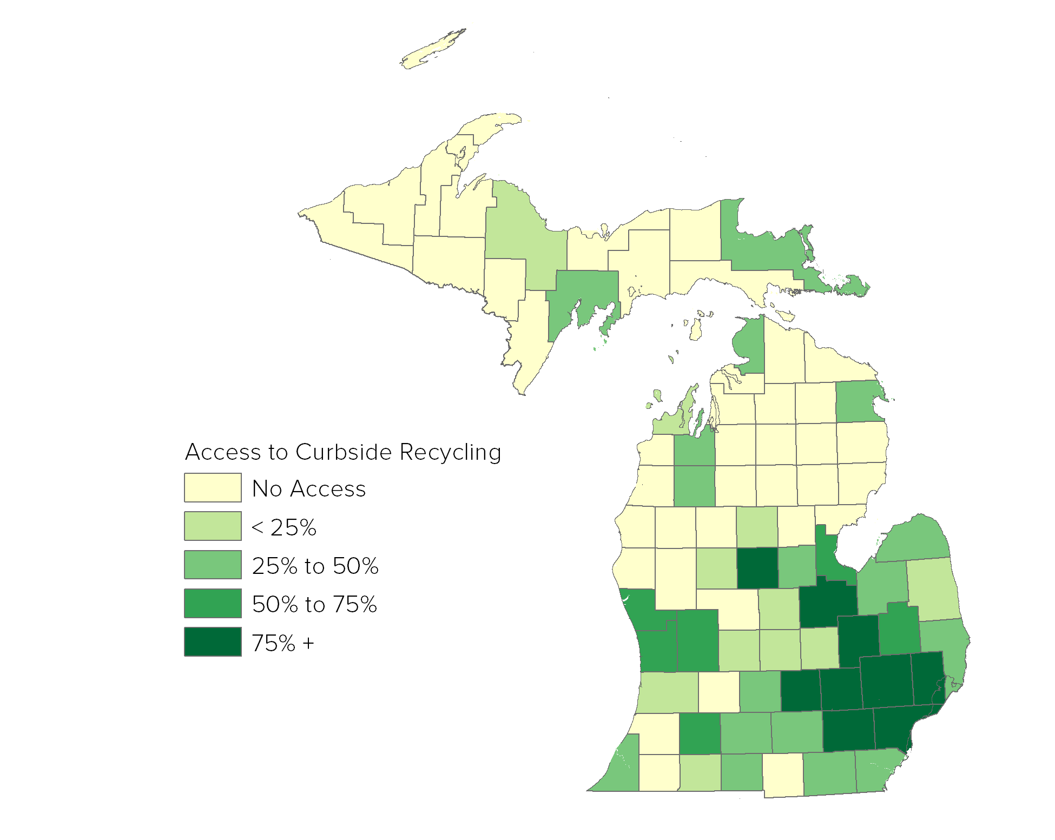
CURBSIDE RECYCLING ACCESS
*
Access varies widely
Higher access in dense/urban areas
Lower in rural areas
Some available by subscription only
Notes:
You can see that curbside availability varies widely across the state
It’s generally available in dense regions
Rural regions have less

Slide 17
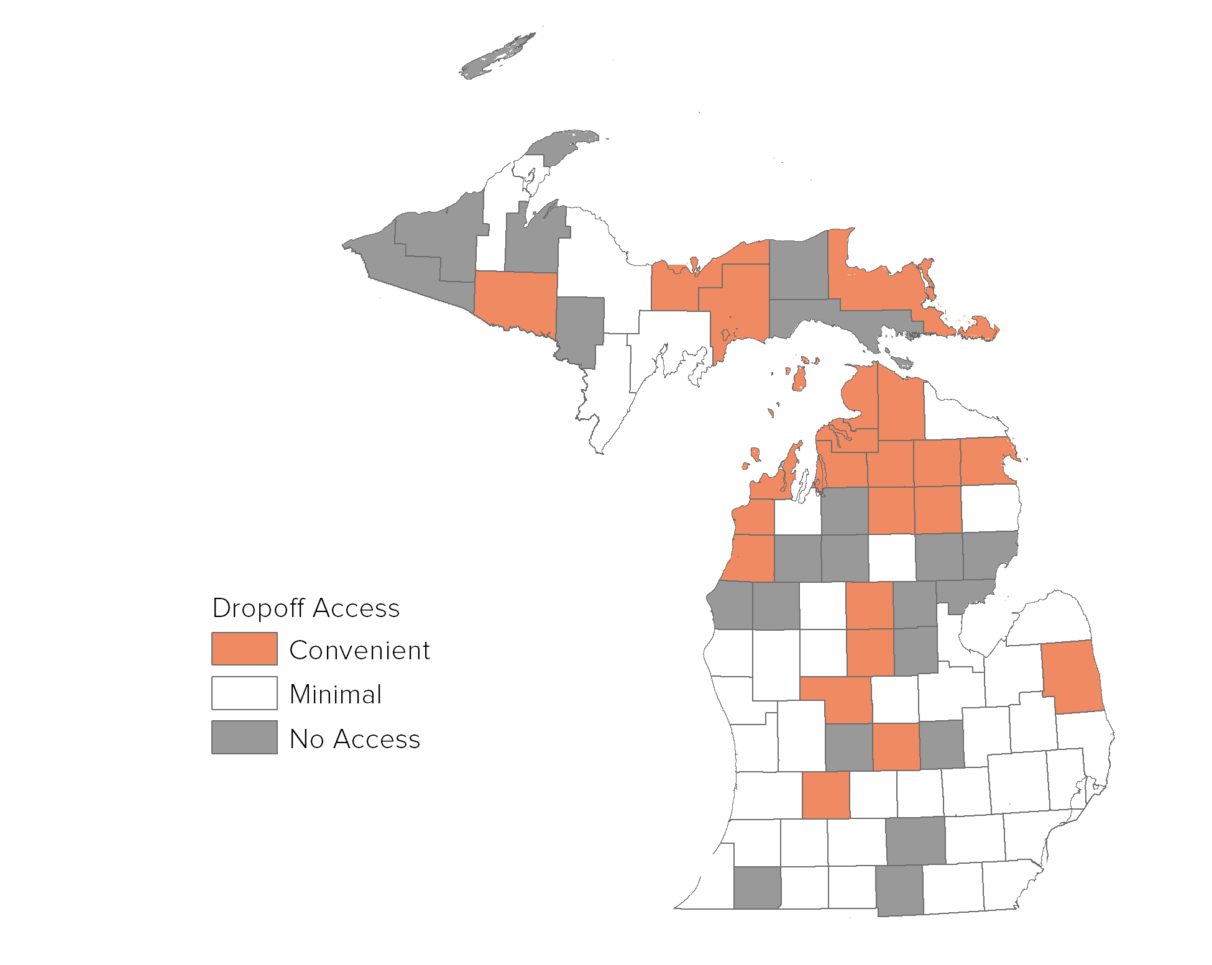
DROPOFF ACCESS
*
At least 1 in county open to public
Notes:
You can see in this visual that access to drop-off facilities is much higher in the rural areas.
In MRI study, Dropoff access was measured by county.
So by minimal access, we mean there is a drop-off location available to residents within the county.
→

Slide 18
NOT ALL DROPOFF ACCESS IS EQUAL
*
Median
> 35k residents
Notes:
1. However, minimal county access isn’t a the ideal measure of practical access to recycling…
2. The average county population is 35k residents, and it may be impractacle to recycle regularly at a single location that is located across the county.

Slide 19
CONVENIENT DROPOFF
*
At least 1 for every 10,000 residents
Notes:
3. So we define convenient dropoff which refers to at least 1 drop-off for every 10k residents

Slide 20
ACCESS PROFILES
*
Convenient Dropoff
219K
Municipal or Contracted Service
1.9M
Minimal or No Access
1.3M
Subscription Curbside
488K
Notes:
So what were the results? Here they are broken out by access type.
Your eyes are probably going to the massive bubble, representing the nearly 2M HH that have curbside access either provided through operations administered by the local municipality or through service that is contracted through a 3rd party
The small bubble on the left represents the nearly ½ million HH that have access, but receive it through subscription services
Together, about 2.4M HH in Michigan have access to curbside service.
The remaining 1.5M HH have no curbside access.
219K of them have convenient access.
1.3M have minimal or no access to recycling.

Slide 21
PARTICIPATION IN RECYCLING
*
Notes:
Let’s move on to participation.

Slide 22
What does recycling participation mean?
Notes:
Let’s define what we mean here. If you’re involved in recycling, you’ve probably heard this phrase used in different contexts.
Participation has a 2-part meaning.

Slide 23
01.
02.
How many people participate in the recycling system?
How much material do they recycle?
Notes:
Let’s look at the first metric.

Slide 24
RANGE OF PROGRAM PARTICIPATION RATES
*
Average drop-off participation (reported) – 9%*
Average subscription participation (estimate) – 15%
Statewide participation rate (combined) – 38%
Average curbside participation (reported) – 67%*
0%
20%
40%
60%
80%
100%
* Weighted by size of program
Notes:
We looked at participation rates in dropoff, subscription and contracted curbside.
These rates were estimates from the survey of recycling program coordinators
Some coordinators had actual data on the number of setouts while others estimated the percent of residents using the program
Reported participation rates ranged from <1% to 95%
There were curbside and drop-off programs at the low and high extremes of the scale
But curbside rates tended to be higher, awith the average reported participation at 67%.
That’s over 6 times the reported participation rate for drop-offs which were at 9%. (This average was adjusted for program size)
The subscription participation rate, or ‘uptake rate’ as we call it sometimes, was assumed to be 15% for our purposes.
So to recap, that leads us to a statewide participation rate of 38% which was estimated based on the reports from different program types and adjusted for the prevalence of that program in the state.

Slide 25
01.
02.
How many people participate in the recycling system?
How much material do they recycle?
Notes:
But there’s another way to think about participation, because setting a bin out only tells part of the story. Of the people who do set out their recycling bin…how full is it? We like to measure this in terms of LB/participating HH.
It helps us answer the question of how to get more material recycled. Do we need more people to set out bins? Or do we need to make our existing recyclers better at it?

Slide 26
RESULTS
Curbside recycling participants recycle 300-840 lbs/participating household/year
MEDIAN
570 lbs per participating household annually
Notes:
For many respondents, participation data was given but no tonnage data, or vice versa. The project team analyzed information and deciphered program data from surveys submitted by programs that had both participation data and tonnage data, and found that some interesting patterns surfaced.
Pounds per participating household is calculated by dividing total LBs by the # of total eligible households multiplied by the participation rate
The result is 570 lbs/hh/year
This is actually consistent with national averages for single stream recycling programs using carts.

Slide 27
PARTICIPATION PROFILES
DENSE URBAN
540 LB
Per Participant
50% Participation
*
LARGE
SUBURBAN
WITH CARTS
720 LB
Per Participant
75% Participation
HAVE BINS
375 LB
Per Participant
75% Participation
Notes:
As we unpacked the results, we found communities fell into a few distinct clusters.
- High performing communities – 720 lbs/hh/year is a lot! These tended to be suburban communities with cart programs.
- Medium performers – 540 lb/hh/year is very typical nationally. These results were found in some of our larger urban cities across the state.
- Lower performers – 375 lb/hh/year is typical of a bin program.

Slide 28
PARTICIPATION GAPS
*
Boosting participation in urban areas
Increasing availability of carts
Notes:
To sum it up, we didn’t find that the recyclers in generally don’t perform well – rather, our research shows that we simply don’t have enough recyclers.
What should we do? We can target the gaps in bigger cities and lower performing suburbs and rural areas. Carts are high priority!

Slide 29
RECYCLING RATE
*
Notes:
And speaking of summing it up, let’s talk about the rate of recycling.

Slide 30
What gets recycled?
Notes:
Task 3 was to measure the rate of recycling in the state, or the relative amount of recycled to total material.
We adhered to EPA guidelines in collecting data and the scope of materials we considered as MSW, meaning
■ Included only the standard scope of MSW.
■ and we include only standard recycling activities.

Slide 31
RECYCLING STREAM COMPOSITION
*
1.4M
Tons
Notes:
We found 1.4M tons of material was recycled in Michigan in 2013.
Of the total amount of material recycled:
only 44% is composed of ‘traditional’ recyclable materials collected from commercial and residential sources.
26% of the total is composted organics, mostly yard waste.
The container deposit program accounts for 11%, and
other source separated streams (such as lead-acid batteries, white goods, tires, e-waste, and textiles) make up the remaining 19%

Slide 32
RECYCLING STREAM COMPOSITION
*
1.4M
Tons
Notes:
This characterization is based on an average of data received from 11 MRFs, ranging from small to large.

Slide 33
DISPOSAL IN MICHIGAN
*
Notes:
So let’s put that in perspective. We dispose in landfills and incinerators, so landfill quantities were first adjusted to avoid double-counting incinerator ash, then added to the total incoming quantities of incinerated materials less the recovered metal quantities, yielding a total disposed tonnage of 8 tons.

Slide 34
RECYCLING RATE
*
TONS RECYCLED
=
RECYCLING RATE
TONS RECYCLED
TONS DISPOSED
+
Notes:
Putting that together with the recycling data we measured, and dividing tons recycled by the total material recycled and disposed, we can calculate a recycling rate.

Slide 35
RECYCLING RATE
*
1.4M TONS RECYCLED
=
15%
1.4M TONS RECYCLED
8.0 TONS DISPOSED
+
Notes:
The recycling rate for Michigan turns out to be 15%.

Slide 36
15%
12.7%
18.7%
10%
15%
20%
Notes:
The baseline measurement of recycling is 15%. Since modeling for data gaps will always leave a range of certainty, we applied the most reasonable assumptions to our baseline scenario yet wanted to perform a sensitivity analysis to see the potential range.
In a Conservative Scenario where Conservative values taken for assumptions across all categories, we would end up at a recycling rate of 12.7%
In an Aggressive Scenario where more generous assumptions made across all gaps, we would end up at a recycling rate of 18.7%
So that gives a sense of the confidence interval

Slide 37
So how do we achieve Governor Snyder’s Goal of 30%
Notes:
So let’s switch gears and focus on how we might reach Governor Snyder’s Goal of 30%
In short, there’s no single answer, but let’s explore a set of aggressive measures and see how it might be possible.
The following statistics are generated by the model RRS developed to calculate the recycling rate – it allows us to tweak certain variables to see the impact on the system.
Let’s see what the cumulative impact some of the levers looks like.

Slide 38
Notes:
These thoughts, although informed by our research and modeling efforts, will not be directly from the perspective of the MRI, but from the my own perspective and based on the extensive experience we have at RRS in material recovery.

Slide 39
49%
25%
15%
28%
37%
13%
Notes:
Here is a quick ballpark comparison to neighboring states for high-level reference, but it’s important to remember that comparisons between states have serious limitations as states approach the measurement in different ways.
Neighboring state estimates are based on 2009 report from Columbia University
---
MN, WI, OH, IL – most recent Columbia University study: http://www.seas.columbia.edu/earth/wtert/sofos/Dolly_Shin_Thesis.pdf
IL – 2009 IL EPA report http://www.epa.state.il.us/land/landfill-capacity/2009/report.pdf

Slide 40
Capturing more of the remaining 85%
Notes:
So if we are currently capturing 15% of the waste stream, what about that other 85%?
What is it? How can we capture a bigger slice of it? What fraction is feasible?

Slide 41
Recyclable – 40%
Notes:
Here’s an illustration that is an RRS representation of the total waste stream. Each dot represents 1% of the total.
Right now, RRS estimates that 40% of materials are recyclable today with the technologies we currently use.

Slide 42
Compostable – 30%
Recyclable – 40%
Notes:
Another 30% is made of organic material that is compostable, or suitable for further processing such as AD. Food waste is an immense component of organics that are not currently being recovered. These organics are environmentally important because they play such a critical role in rapid anaerobic decomposition and methane generation.

Slide 43
“Designable” – 10%
Compostable – 30%
Recyclable – 40%
Notes:
Another 10% of material could theoretically be recycled but is not as a result of practical limitations. These limitations can be overcome through improved product and packaging design as well as recovery technology design. Think poly-laminate films, for example, like chip bags and #7 plastics.

Slide 44
Hardest to recover – 20%
“Designable” – 10%
Compostable – 30%
Recyclable – 40%
Notes:
The remaining 20% is not practically recoverable - diapers, broken broomsticks, urethanes, etc.

Slide 45
Hardest to recover – 20%
“Designable” – 10%
Compostable – 30%
What
we’re capturing now
Recyclable – 40%
Notes:
This box represents the 15% that Michigan is currently capturing. 12% recovered recyclable material and 3% is recovered organics.
How can we expand this to 30 of the little dots?

Slide 46
Improve current curbside programs to best practice recovery levels.
Notes:
What if current curbside programs were to achieve best-practice 550 lbs/hh instead of the 433 average AND all subscription programs were to achieve universal access?

Slide 47
Improve current curbside programs to best practice recovery levels.
  433 → 550 (lbs/hh)
  LB Recyclables per Household Annually
Notes:
How could we do this?
Could be accomplished through a combination of efforts:
policy interventions (like mandatory bundling of recycling service with trash service) and
increased education and outreach.
Performance Incentives
Best practices in service offerings – pickup schedules, etc.

Slide 48
Improve current curbside programs to best practice recovery levels.
16%
Notes:
This adds one percentage point.

Slide 49
Expand curbside programs to all cities larger than 25,000 residents.
Notes:
Another focus could be on building out the access footprint
- Assume that any community greater that 25k residents is suitably dense to support curbside collection
- Assume that they can get the same best practice recycling system described previously.
- This would cover Detroit, Grand Rapids, Flint, along with 20 or so others.

Slide 50
Expand curbside programs to all cities larger than 25,000 residents.
  88-163 → 550 (lbs/hh)
  LB Recyclables per Household Annually
Notes:
Many of these communities are served by minimal or convenient drop-off recycling and would see significant improvement.

Slide 51
Expand curbside programs to all cities larger than 25,000 residents.
17%
Notes:
Another percentage point.

Slide 52
Increase best practice access to curbside carts for all single-family homes.
Notes:
This is because 8+ million tons in the landfill is difficult to offset with only 4 million households.
What if we focus on households in state in smaller municipalities?
Ok, so what if we give the 550 lbs/hh to every single family home in the state?
This has serious practical limitations, but for the sake of exploring this challenge, let’s see what happens.

Slide 53
Increase best practice access to curbside carts for all single-family homes.
19%
Notes:
2 percentage points.

Slide 54
Increase commercial recycling and improve reporting of commercial recycling activity.
Notes:
Capture more commercial material. Improve documentation of this material flow.
Difficult to measure because it’s not widely reported. We have reason to believe there is a lot of material not being recovered, but we also think there is substantial OCC that we weren’t able to account for in MI.
Use policy tools to mandate commercial recycling.

Slide 55
Increase commercial recycling and improve reporting of commercial recycling activity.
24%
Notes:
This represents a possible 400k additional tons which is likely around the amount of uncaptured shredded paper and OCC.
The MRI team assumed that 33% of the recycling stream was commercial, and used that figure.

Slide 56
Capture 1/3 of food waste statewide
  Residential
  +
  Commercial
Notes:
To estimate food waste, look at the estimated generation based on commercial and residential sources,
- 513k tons total residential food waste
- 662k tons commercial food waste
- consider the impact of capturing 1/3 of it.

Slide 57
Capture 1/3 of food waste statewide
30%
Notes:
Another 4 percentage points and we’re at 30%.
So again, I’m not offering these actions as specific recommendations, but hopefully it gives some perspective into the types of activities that would make a real difference for Michigan.

Slide 58
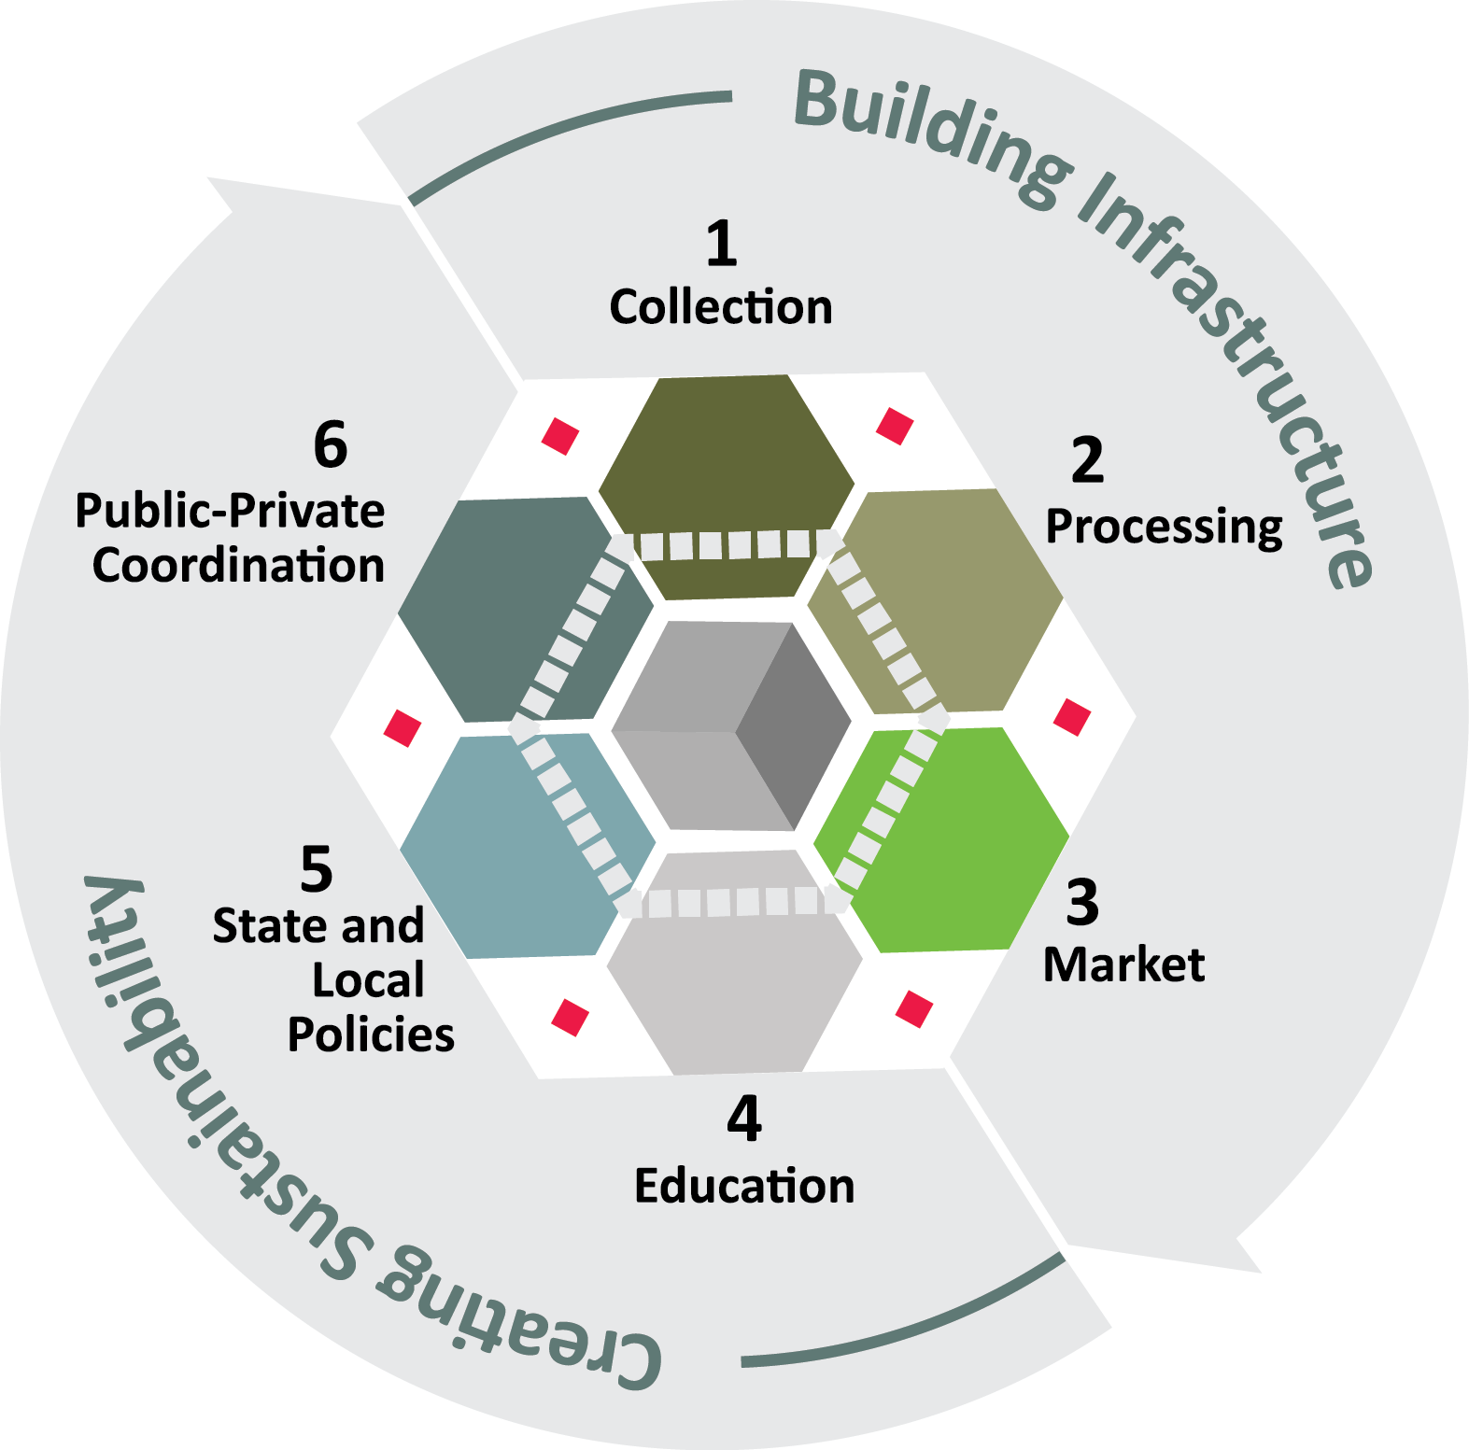
Notes:
We know it’s important to create a robust system that doesn’t solely focus on one area by itself. Matt gave you a comprehensive list of what DEQ is working on.
1. Infrastructure is fundamental. Residents and businesses need robust collection opportunities that are convenient and economical.
2. We’ve got robust processing infrastructure in the state, including MRFs, mills for paper and national leaders in plastics processing
3. As Matt mentioned, it’s critical to have strong markets – we know businesses want the material, and you may have heard P&G talk about that very topic at the Governor’s Summit on Recycling.
4. Education. Need more. Need often, and consistent messaging.
5. Policies at the state level and local levels can have a real impact. We’re seeing more action in various states focused on the elephant in the room - organics. I think this trend will continue to gain momentum.
5. We need involvement throughout the supply chain and the public-private collaboration to which Matt referred. We need cooperation between state, municipal gov’ts, and the private players that operate much of the supply chain.
These are the components that are part of the multi-faceted approach that we’ll need to raise the bar make Michigan a recycling leader, positioning us to manage materials and resources sustainably long into the future.

Slide 59


Hunt Briggs
Project Manager
hbriggs@recycle.com
Thank You!
RRS (Resource Recycling Systems)
@recycle_com
Resource Recycling Systems
Notes:
If you’d like to learn more about the project, much more detail can be found in the project report, which can be downloaded from the DEQ website.
If you have additional questions for us, you may also contact RRS and we’d be happy to answer your questions.
Thank you! At this point I’ll hand it back over to the DEQ.

